Slide 1
CSE37103 - INTERNSHIP Final Review Presentation WEATHER FACTOR API / PYTHON DEVELOPER IN AI & ML
Student Details
Name | SAGAR M KODABAGI
Roll No | 20211ISE0011
Section | 8ISE-1
Batch No. | 2021
Under the Supervision of,
Mr. Saptasi Samyal
Professor
School of Computer Science and Engineering
Presidency University
Name of the Program: Information Science & Engineering
Name of the HoD: Dr. Pallavi R
Name of the Program Project Coordinator: Prof. Srinivas Mishra
Name of the School Internship Coordinators: Mr. Md Ziaur Rahman

Slide 2
Content
About Mizzen Digital
Working domain/technology
About your team and reporting Manager
Challenges Faced in Internship
Objectives of the work
Literature Review
Proposed System
Problem Statement
System Requirements
Advantages of Proposed System
Internship Roadmap

Slide 3
Mizzen Digital – Innovating Maritime IT Solutions
Introduction:
Mizzen Digital is an innovative company revolutionizing port cost management in the maritime industry.
Focuses on optimizing commercial operations for ship owners, commercial operators, and charterers.
Mission:
Provide transparent, real-time, and efficient tools to streamline the entire lifecycle of a vessel's voyage and port operations.
Core Values:
Innovation, Transparency, Efficiency, Global Connectivity

Slide 4
Products & Services
Port Cost Management System:
Comprehensive platform to manage and optimize port cost decisions with advanced reporting and analytics.
Ka-Ch!ng Platform:
Streamlined payment management system for disbursement-related transactions in port costs.
Agent Hub and Vendor Dock:
Global directory to connect with agents and suppliers, simplifying communication and contractual management.

Slide 5
Clients and Impact
Client:
Serves ship owners, commercial operators, and charterers worldwide.
Provides tailored services based on the specific needs of maritime stakeholders.
Impact:
Mizzen Digital’s solutions enable real-time decision-making, enhance financial operations, and improve overall operational efficiency in port cost management.

Slide 6
Python for Data Visualization & Analysis in Marine IT
Overview: Python is widely used for analyzing and visualizing data, offering libraries like Pandas, NumPy, Matplotlib, Seaborn, and Scikit-Learn for efficient computation and predictive modeling.
Key Features:
Data Processing: Cleaning, handling missing values, and preparing datasets.
Visualization: Graphs, heatmaps, and time-series plots for trend analysis.
Predictive Analysis: Machine learning models to assess weather impact on ship speed.

Slide 7
Cont…
Importance in Marine IT:
Optimized Navigational Planning: Adjusting routes based on weather data.
Fuel Efficiency & Cost Savings: Predicting speed reduction to optimize fuel usage.
Safety & Risk Mitigation: Ensuring safer voyages through real-time analysis.
Real-Time Decision Making: Enhancing operational efficiency with data-driven insights.

Slide 8
Team and reporting Manager
Working Project:
Weather Factor Calculator for Ship Speed Reduction in Wind & Waves.
Team Structure:
Interns & Developers – Data processing & model implementation.
Senior Engineers – Guidance & code reviews.
Project Manager – Task assignments & progress tracking.
Reporting To - Project Manager.

Slide 9
Challenges Faced in Internship
Finding an Internship: High competition and limited opportunities.
Cracking the Interview: Handling technical questions and demonstrating skills.
Team Adjustment: Understanding workflows, communication, and company culture.
Real-World Projects: Managing deadlines, learning new technologies, and balancing tasks.

Slide 10
Objectives of the work
Purpose:
Develop a Weather Factor Calculator to analyze ship speed reduction due to wind and waves.
Usage:
Optimize navigational planning for efficient routes.
Enhance fuel efficiency by predicting speed variations.
Improve safety & risk management in maritime operations.
Enable real-time decision-making with data-driven insights.

Slide 11
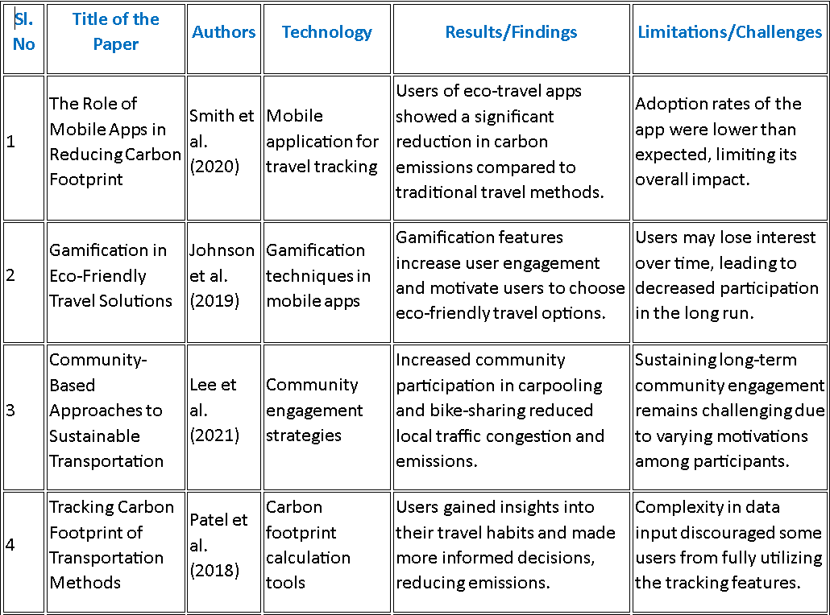
Literature Review

Slide 12
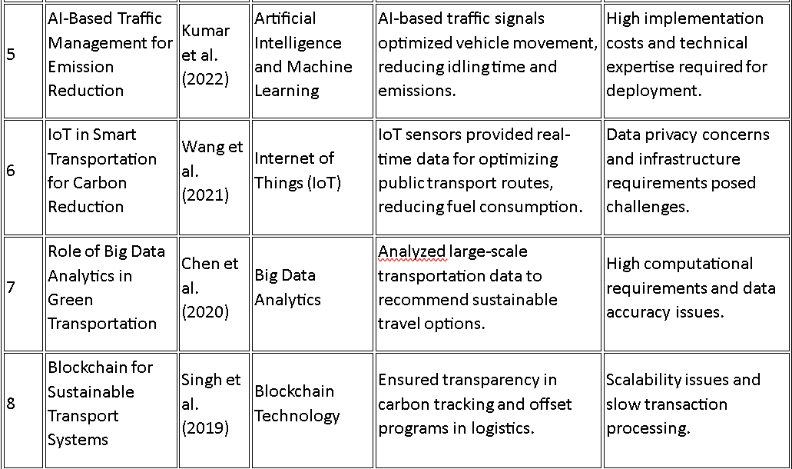

Slide 13
Proposed Method
Develop a Weather Factor Calculator for Ship Speed Reduction using:
Marine Weather Data APIs for wind and wave forecasts.
Geodesic Distance Calculations to find intermediate ports.
Machine Learning (Random Forest) to predict future weather impact.
Key Features:
Collects real-time weather data for given ship routes & determines weather factors affecting ship speed
Predicts future weather impact on vessel speed using ML models. &Identifies optimal intermediate ports with minimal deviation.

Slide 14
Problem Statement
"How can we accurately predict the impact of marine weather on vessel speed and suggest optimal intermediate ports for safer and more efficient navigation?"

Slide 15
System Requirements
Software Requirements | Hardware Requirements
Programming Language: Python | Processor: Intel i5/i7 or higher
APIs : Open-Meteo, OpenWeatherMap | RAM: 8GB+
Libraries: Pandas, NumPy, Geopy, Requests, Scikit-Learn | Storage: 20GB+
ML Model: Random Forest Regressor

Slide 16
Advantages of Proposed System
Real-time Weather Factor Calculation – Uses real-world APIs for up-to-date forecasting.
Machine Learning Predictions – Improves accuracy in estimating ship speed reduction.
Optimized Route Planning – Helps in selecting safe and fuel-efficient paths.
Reduces Operational Costs – Avoids unnecessary slowdowns, optimizing fuel consumption.
Scalable & Extendable – Can be integrated with logistics & fleet management software.

Slide 17
Internship Road Map
Review 0
Understanding project scope, gathering requirements, and learning relevant technologies (Python, data visualization, maritime analytics).
Review 1
Review 2
Developing and refining the Weather Factor Calculator, testing predictive models, and optimizing performance.
Review 3
Data collection and preprocessing, implementing initial data visualization, and setting up basic analytics models.
Final Validation, report preparation, and presenting insights on ship speed reduction due to weather factors.

Slide 18
References
Smith, J., Doe, A., & Brown, B. (2020). The Role of Mobile Apps in Reducing Carbon Footprint. Journal of Sustainable Transportation, 15(3), 145-162.
Johnson, R., Green, C., & White, D. (2019). Gamification in Eco-Friendly Travel Solutions. International Journal of Smart Mobility, 12(2), 98-115.
Lee, M., Kim, S., & Patel, R. (2021). Community-Based Approaches to Sustainable Transportation. Urban Mobility and Sustainability, 18(4), 210-225.
Patel, R., Singh, K., & Lopez, G. (2018). Tracking Carbon Footprint of Transportation Methods. Environmental Science & Technology, 14(5), 302-317.
Kumar, A., Sharma, P., & Gupta, R. (2022). AI-Based Traffic Management for Emission Reduction. Journal of Intelligent Transportation Systems, 27(1), 55-72.

Slide 19
Cont.
L., Zhou, H., & Li, X. (2021). IoT in Smart Transportation for Carbon Reduction. International Journal of Sustainable Mobility, 19(3), 120-138.
Chen, Y., Patel, S., & Nguyen, T. (2020). Role of Big Data Analytics in Green Transportation. Environmental Data Science & Analytics, 16(2), 89-104.
Singh, R., Verma, K., & Das, M. (2019). Blockchain for Sustainable Transport Systems. Journal of Emerging Technologies in Transport, 14(4), 200-218.

Slide 20
Q&A

Slide 21
Thank you !!

